Slide 1


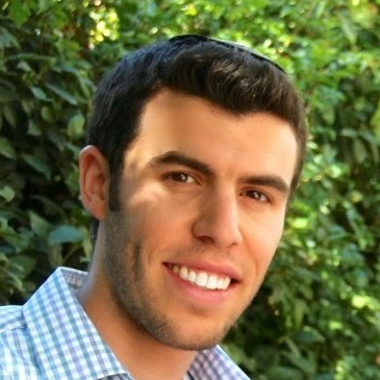
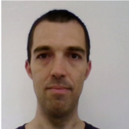

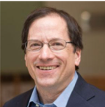



SpeedNet
Learning the Speediness in Videos
Sagie
Benaim
Ariel
Ephrat
Oran
Lang
Inbar
Mosseri
Bill
Freeman
Miki
Rubinstein
Michal
Irani
Tali
Dekel

Slide 2
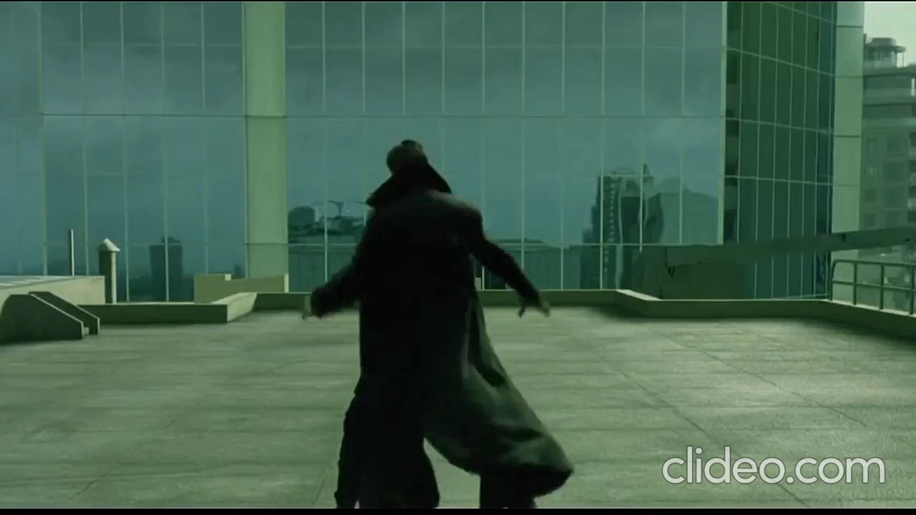
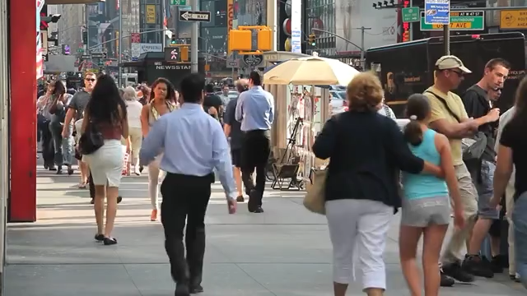
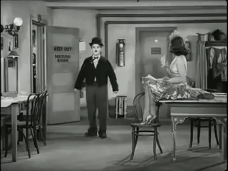
Automatically predict “speediness”
Slower
Normal speed
Faster
Notes:
When we watch a video, we can often easily tell the “speediness” of videos:
Whether videos are slower than normal speed <click> At normal speed <click> Or faster than normal speed <click>
We can do so because we know how objects such as people or cars move in the world and their natural rate of motion.
In this work, our goal is to automatically predict speediness in videos. But why is this a useful task to solve?

Slide 3
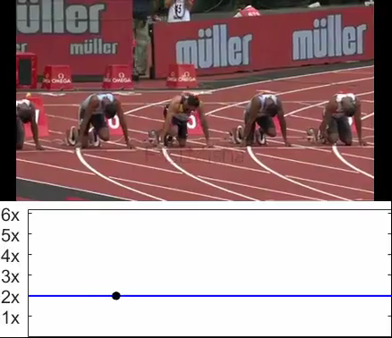
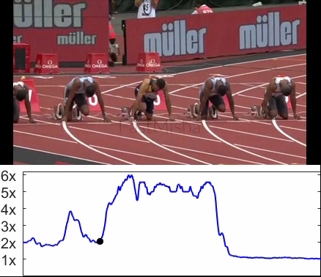
Automatically predict “speediness”
Uniform Speed Up (2x)
Adaptive speed up (2x)
Other Applications:
Self-supervised action recognition
Video retrieval
Notes:
Consider the task of taking an input video and speeding it up. <click>
On the left side, we speedup of a video of athletes sprinting, uniformly, at twice the original speed.
This results in undesirable and unnatural jittery motion. <click>
Our method can be used to <CLICK> adaptively change the speed rate based on the video content.
Here’s the same video sped up using our method based on speediness prediction. It has the same total duration as the previous uniformly sped-up one. <click>
As you can see it’s much more natural-looking <click>.
In addition to adaptive speedup predicting speediness gives rise to other applications such as <CLICK> self-supervised action recognition, and <CLICK> video retrieval.
Additional applications are provided in the paper.

Slide 4
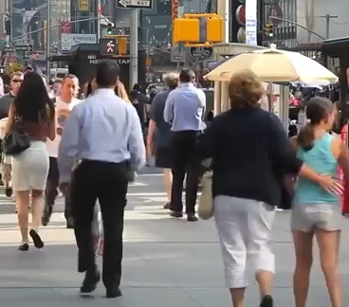
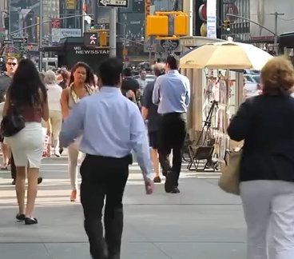
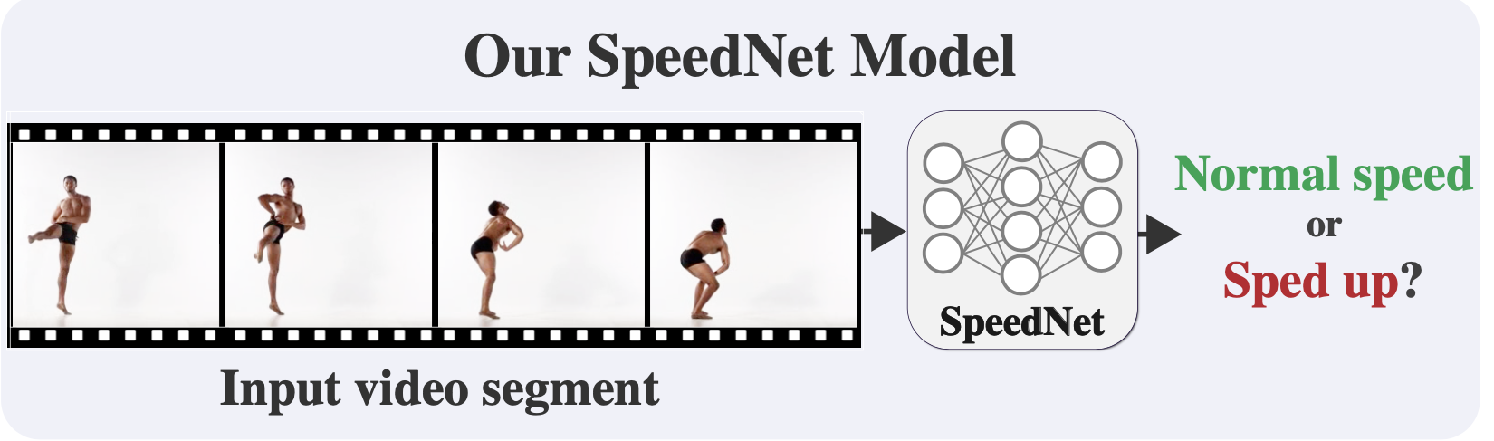
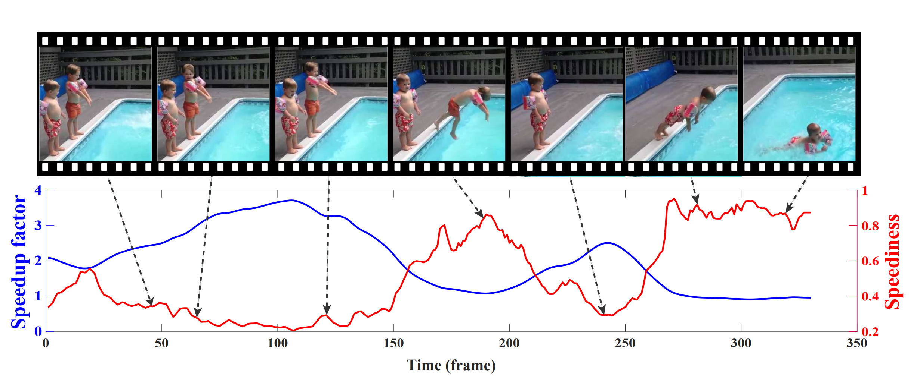
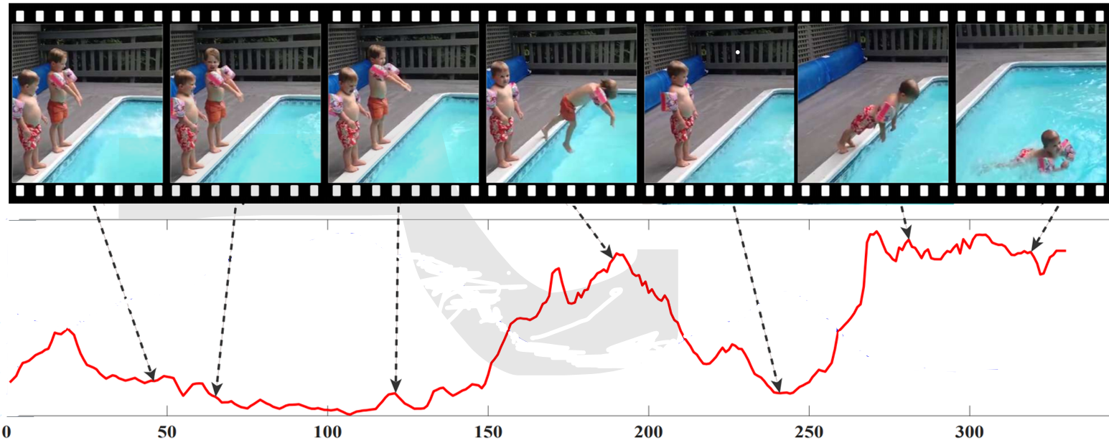





SpeedNet
Self-supervised
training
Sped Up
Normal speed
Input video
Inference on full sped-up video
Sped-up
Normal speed
Notes:
So how was this done?
We trained a network called “SpeedNet” <CLICK> to classify whether a given video clip <CLICK> [pause] is of normal speed <CLICK> or [pause] sped up <CLICK>.
We train our network on short video clips of 30 frames.
This is done in a <CLICK> self supervised manner with no manual annotations. <CLICK>
At inference time <CLICK>, given a video clip <CLICK> we run our model in sliding window fashion.
We do not expect our model to predict all timesteps perfectly, as some contain little-to-no motion.
As long as the network thinks that certain video parts are not sped-up, we can keep on speeding up those video segments even further.
This gives rise to our adaptive video speedup.

Slide 5
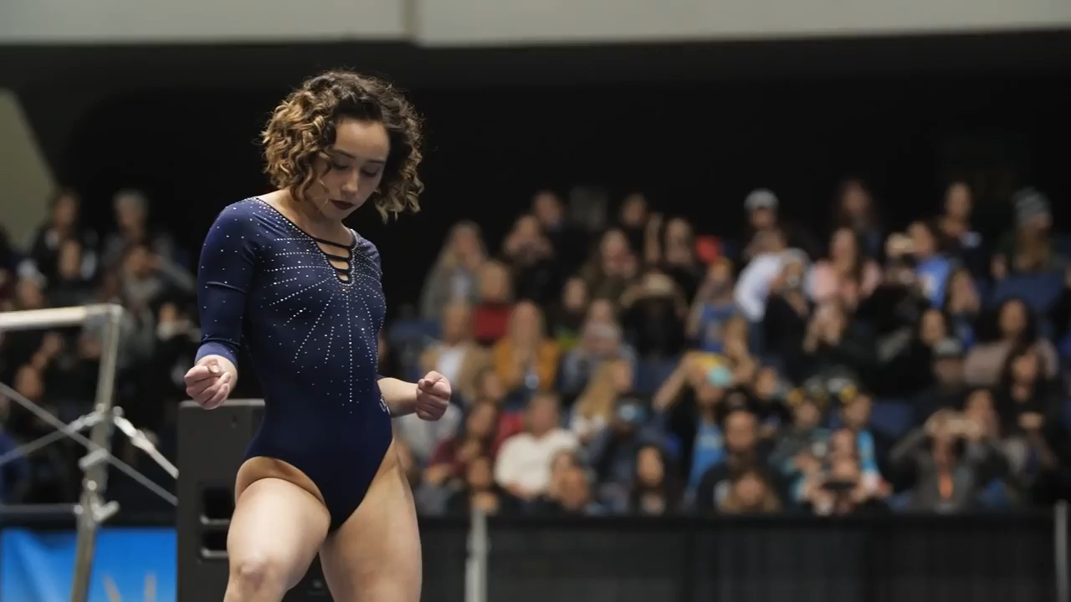
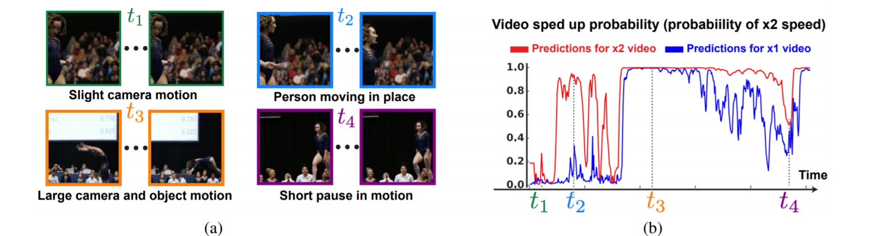
SpeedNet Predictions

Slide 6
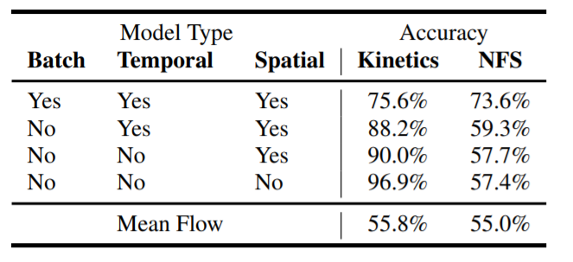
`
SpeedNet ≠ Motion Magnitude
A simple network trained with motion magnitude as input
Motion magnitude correlated with distance to camera
Notes:
To demonstrate the effect of these augmentations, we consider the effect of training without them.
When training SpeedNet without these augmentations, SpeedNet relies on these learned “shortcuts”–artificial cues that are present in Kinetics, which lead to a misleading high test accuracy. However, when tested on another held our dataset called NFS (Need for Speed), such cues are not present, and so the test accuracy drops to 57.4%. When using all of the augmentations, reliance on artificial cues is reduced significantly (accuracy drops from 96.9% to 75.6%), and the gap between the test accuracy of Kinetics and that of NFS drops to 2%, indicating better generalization.

Slide 7
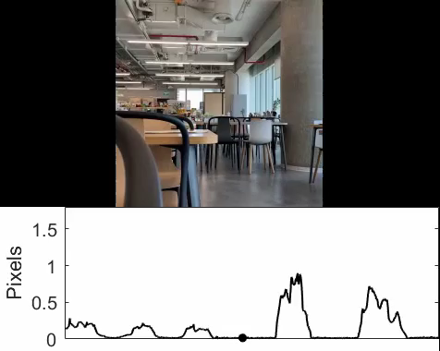
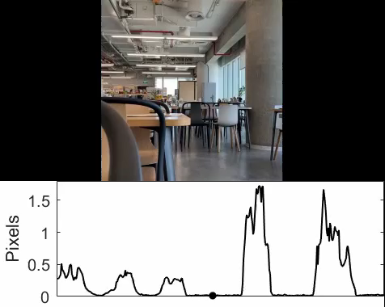
SpeedNet ≠ Motion Magnitude
Motion Magnitude (1x)
Motion Magnitude (2x)
Notes:
Here is a video of a person walking back and forth, at first further away from the camera, then closer to the camera. The magnitude of motions varies significantly throughout the sequence (in particular, the motions get larger when the person is closer to the camera).
<CLICK> The motion magnitude doubles when the same video is played at twice the speed.

Slide 8
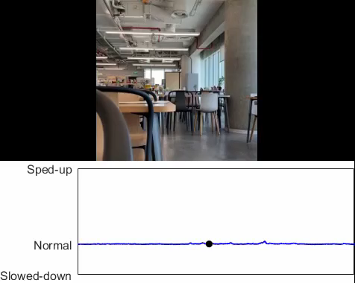
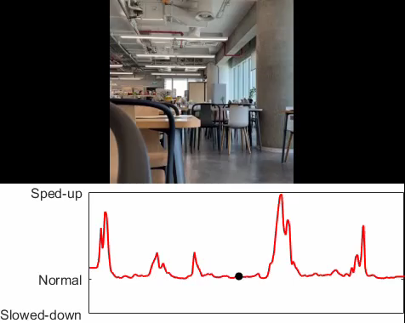
SpeedNet ≠ Motion Magnitude
SpeedNet (1x)
SpeedNet (2x)
Notes:
SpeedNet model is able to produce a stable classification of normal speed throughout the video (speediness score close to zero).
<CLICK> If we input to SpeedNet the video played at twice the speed (2×), then the walking segments do indeed get recognized as faster-than-normal human motions (higher speediness scores), whereas the static segments (no person in the scene), are classified as normal speed.

Slide 9
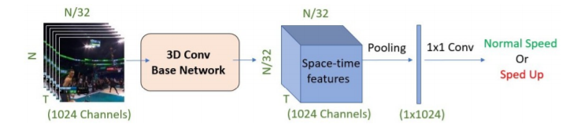
Training SpeedNet
N
(3 Channels)
Spatial Max Pooling
Temporal Average Pooling
Notes:
Our network architecture is largely based on S3D-G, a state-of-the-art action recognition model. There are a number of differences though, and I’ll describe and important one here.
Intuitively, we want the prediction to be determined by the most dominant spatially moving object, whereas temporally, we would like to take into account the motion through the entire video segment to avoid sensitivity to instantaneous “spiky” motions or to regions with no motion. We therefore reduce the spatial dimension by applying global max pooling, and reduce the temporal dimension by applying global average pooling.

Slide 10
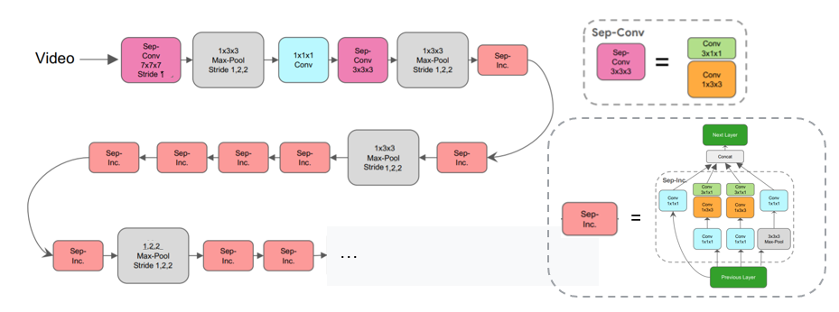
3D Conv Base Network
Adapted from S3D-G: “Rethinking Spatiotemporal Feature Learning”

Slide 11
`
Training SpeedNet: Artificial Cues
Spatial augmentations.
Temporal augmentations
Same-batch training.
Notes:
Previous work has shown networks have a tendency to use shortcuts—artificial cues present in the training data, to help them solve the task at hand. We perform a number of strategies to avoid them
Spatial: During training, we randomly resize the input video clip to various spatial dimensions. The blurring which occurs during the resize process can help mitigate potential pixel intensity jitter caused by MPEG or JPEG compression of each frame. After passing the input through the base network, we perform spatial global max pooling over the regions in the resulting space-time features. Since the input is of variable size, these regions correspond to differently sized regions in the original, unresized input. This forces our network not to rely only on size-dependent factors, such as motion magnitude.
Temporal: We would like to sample a video at either normal speed or twice its normal speed. To introduce variability in the time domain, for normal speed we sample frames at a rate of 1×-1.2× and for the spedup version we sample at 1.7×-2.2×
Same-batch training: each batch contains both normal-speed and sped-up versions of each video clip.

Slide 12
Spatial Augmentations
Fully convolutional network
Random resize between 64 to 336
Blurring helps mitigate potential pixel intensity jitter caused by MPEG or JPEG compression
N
(3 Channels)

Slide 13
Temporal Augmentations
Normal speed sample rate: 1-1.2x
Sped up sample rate: 1.7-2.2x
Randomly skip frames with probability 1 – 1/f where f is randomly chosen randomly in the desired range.

Slide 14
Same Batch Training
Both “normal speed” and “sped-up” version appear in the same batch
Similar to other Self-Supervised works such as “predicting image rotation”

Slide 15
`
Training SpeedNet: Artificial Cues
NFS: Need For Speed dataset taken at 240 FPS
No “Shortcuts” – A gap of 2%
“Shortcuts” – A gap of > 28%
Notes:
To demonstrate the effect of these augmentations, we consider the effect of training without them.
When training SpeedNet without these augmentations, SpeedNet relies on these learned “shortcuts”–artificial cues that are present in Kinetics, which lead to a misleading high test accuracy. However, when tested on another held our dataset called NFS (Need for Speed), such cues are not present, and so the test accuracy drops to 57.4%. When using all of the augmentations, reliance on artificial cues is reduced significantly (accuracy drops from 96.9% to 75.6%), and the gap between the test accuracy of Kinetics and that of NFS drops to 2%, indicating better generalization.

Slide 16
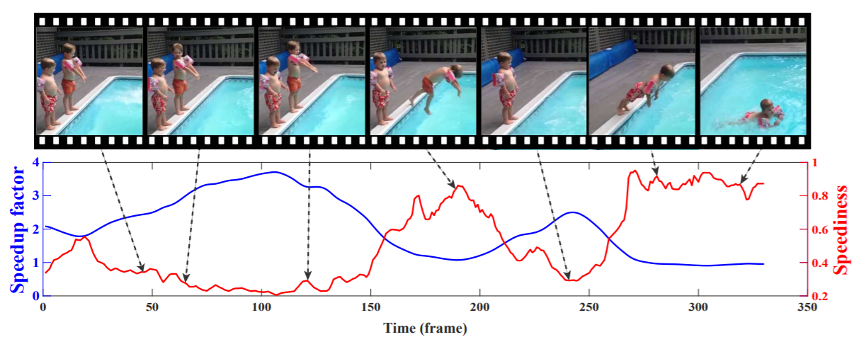
From Speediness to Adaptive Speedup
Original 1x video
1x video (T frames)
2x video (Interpolate to T Frames)
N videos of increasing speed
3x video (Interpolate to T Frames)
…
Nx video (Interpolate to T Frames)

Slide 17





From Speediness to Adaptive Speedup
1x video Speediness Curve
Sped-up
Normal speed

Slide 18
From Speediness to Adaptive Speedup
Original 1x video
1x video Speediness Curve
2x video Speediness Curve
N videos of increasing speed
3x video Speediness Curve
…
Nx video Speediness Curve

Slide 19
From Speediness to Adaptive Speedup
Original 1x video
Low Speediness (for most speedup curves)
1x video Speediness Curve
2x video Speediness Curve
N videos of increasing speed
3x video Speediness Curve
…
Nx video Speediness Curve

Slide 20
From Speediness to Adaptive Speedup
Original 1x video
High Speediness (for most speedup curves)
1x video Speediness Curve
2x video Speediness Curve
N videos of increasing speed
3x video Speediness Curve
…
Nx video Speediness Curve

Slide 21
From Speediness to Adaptive Speedup
Original 1x video
Medium Speediness (only some curves indicate speedup)
1x video Speediness Curve
2x video Speediness Curve
N videos of increasing speed
3x video Speediness Curve
…
Nx video Speediness Curve

Slide 22
From Speediness to Adaptive Speedup
Original 1x video
1x binarized video Speediness Curve
x1
2x binarized video Speediness Curve
x2
Speedup Vector V(t) = Max of
3x binarized video Speediness Curve
x3
…
Nx binarized video Speediness Curve
xN

Slide 23
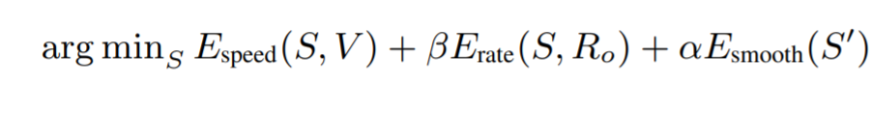
From Speediness to Adaptive Speedup
Original 1x video
Final step: Estimate a smoothly varying speedup curve
Espeed = S should be close to V(t) – our estimated Speedup Vector
Erate = the total frame rate should be the desired frame rate (e.g 2x or 3x)
Esmooth = smoothness regularizer using the first derivatives S’

Slide 24
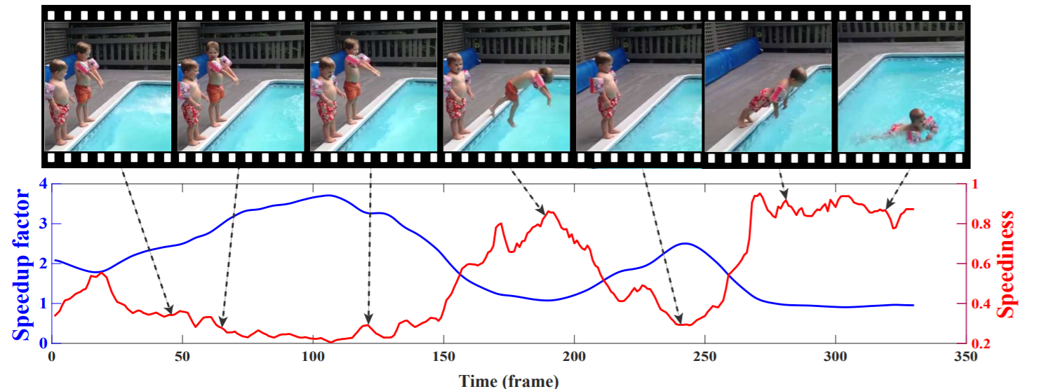
From Speediness to Adaptive Speedup
2x final “speediness curve” (blue):

Slide 25
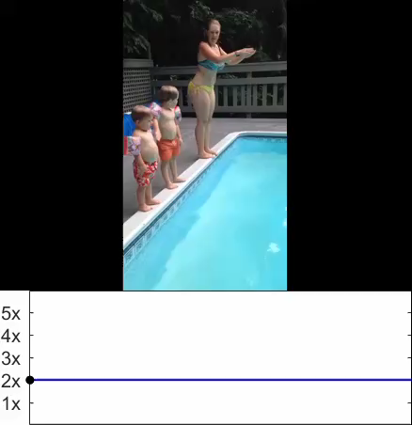
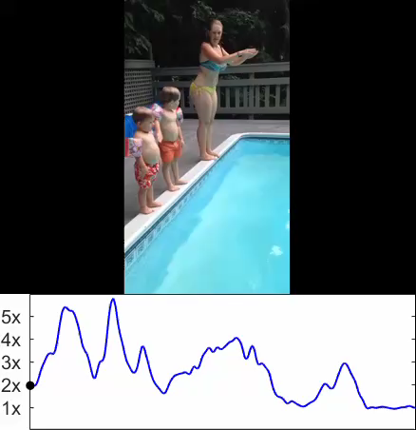
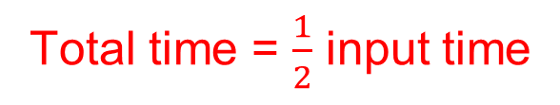
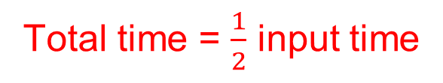
Adaptive video speedup
Total time = $\frac{1}{2}$ input time
Total time = $\frac{1}{2}$ input time
Speedup
Speedup
Time
Time
Uniform Speedup
Adaptive Speedup (ours)
Notes:
We can now use our speediness predictions to adaptively speed-up videos.
<CLICK> Here we can see video of a dancer was uniformly sped up by 2x, so it’s duration is half of the original duration.
<CLICK> On the right we used our adaptive speedup instead: Each segment in the video was sped up as long as SpeedNet determined the segment to be of normal speed.
Our result has the same duration as the uniformly speedup result, but is much more natural, and less jittery. <CLICK>
We performed a user study in which users preferred our adaptive speedup in all cases.

Slide 26
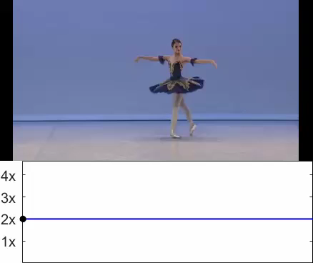
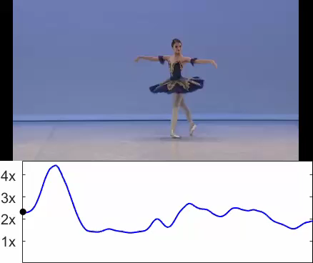
Adaptive video speedup
Total time = $\frac{1}{2}$ input time
Total time = $\frac{1}{2}$ input time
Speedup
Speedup
Time
Time
Uniform Speedup
Adaptive Speedup (ours)
Notes:
We can now use our speediness predictions to adaptively speed-up videos.
<CLICK> Here we can see video of a dancer was uniformly sped up by 2x, so it’s duration is half of the original duration.
<CLICK> On the right we used our adaptive speedup instead: Each segment in the video was sped up as long as SpeedNet determined the segment to be of normal speed.
Our result has the same duration as the uniformly speedup result, but is much more natural, and less jittery. <CLICK>
We performed a user study in which users preferred our adaptive speedup in all cases.

Slide 27
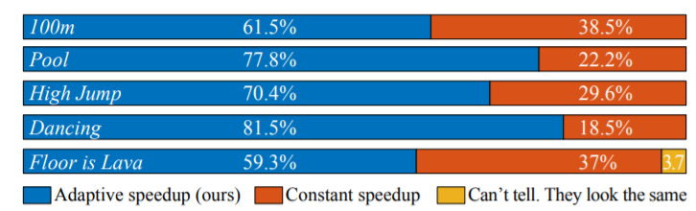
Adaptive Speedup Preferred in all videos of a user study

Slide 28
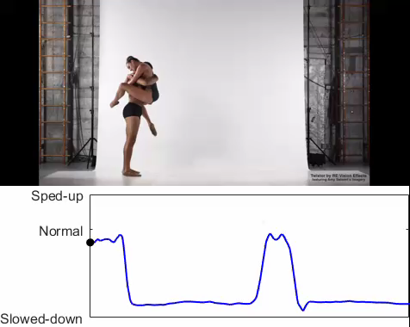
Generalization to Slowed Down Videos
Notes:
Our method can also be used to detect slowed down regions of a video, even thought it was not trained on such slowed down video segments. To emphasise, the detection is based on speediness and not motion magnitude, as I described earlier.

Slide 29
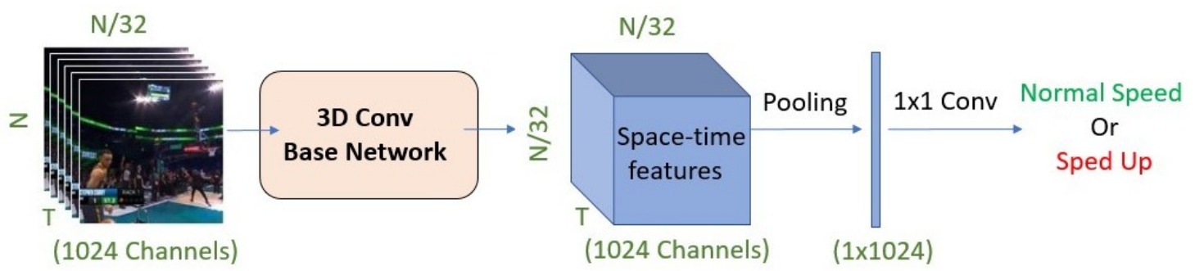
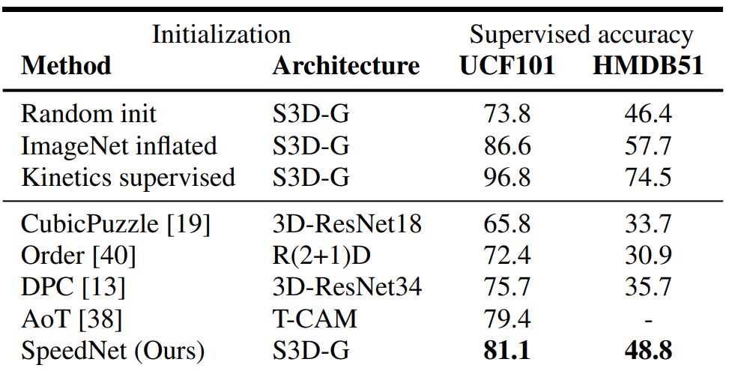
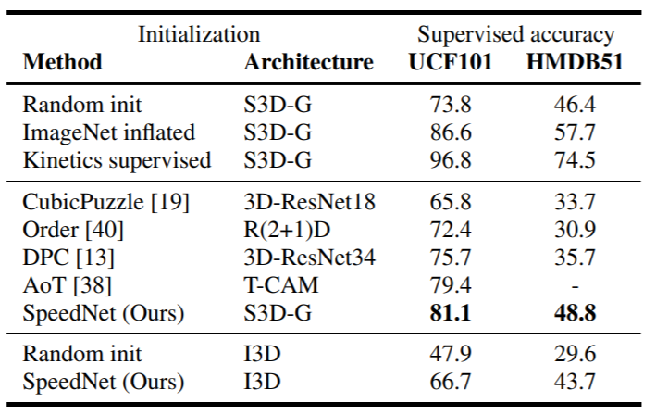
Other self supervised tasks
Train SpeedNet
Self Supervised Action Recognition
Notes:
SpeedNet can be used in other self supervised tasks <CLICK>. We first train SpeedNet on a large corpus of videos of Kinetics in a self supervised manner. <CLICK>
We then utilize the space-time representations SpeedNet learned <CLICK>, and finetune our model for action recognition <CLICK>. Our method beats all other models pre-trained in a self-supervised manner on Kinetics <CLICK>.
Our model can also be used for video retrieval <CLICK>. We extract a SpeedNet embedding <CLICK> for the query clip <CLICK> , and find nearest neighbors in embedding space from within the same video <CLICK> or even for a query clip <CLICK> across videos <CLICK>.
Note that SpeedNet was not trained specifically for action recognition, so some of the neighbours are not of the same class, but contain similar motion patterns.
For example <CLICK> a person free falling in the sky has a similar motion patter to a person surfing. .

Slide 30
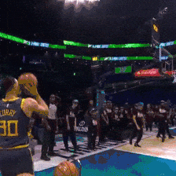
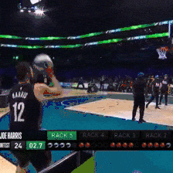
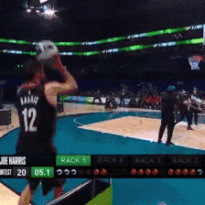
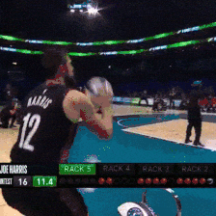
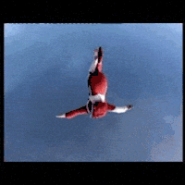
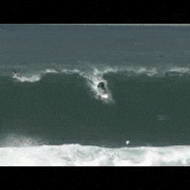
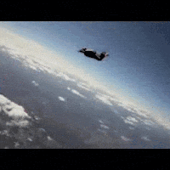
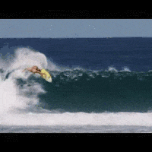
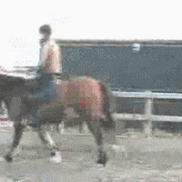
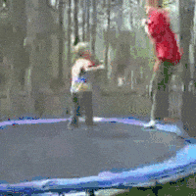
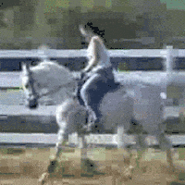
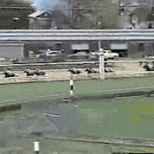
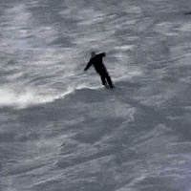
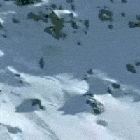


Other self supervised tasks:
Video Retrieval
Train SpeedNet
Query
Retrieved top-3 results (Within)
Query
Retrieved top-3 results (Across)
Notes:
SpeedNet can be used in other self supervised tasks <CLICK>. We first train SpeedNet on a large corpus of videos of Kinetics in a self supervised manner. <CLICK>
We then utilize the space-time representations SpeedNet learned <CLICK>, and finetune our model for action recognition <CLICK>. Our method beats all other models pre-trained in a self-supervised manner on Kinetics <CLICK>.
Our model can also be used for video retrieval <CLICK>. We extract a SpeedNet embedding <CLICK> for the query clip <CLICK> , and find nearest neighbors in embedding space from within the same video <CLICK> or even for a query clip <CLICK> across videos <CLICK>.
Note that SpeedNet was not trained specifically for action recognition, so some of the neighbours are not of the same class, but contain similar motion patterns.
For example <CLICK> a person free falling in the sky has a similar motion patter to a person surfing. .

Slide 31

Other self supervised tasks:
Video Retrieval
Train SpeedNet
Notes:
SpeedNet can be used in other self supervised tasks <CLICK>. We first train SpeedNet on a large corpus of videos of Kinetics in a self supervised manner. <CLICK>
We then utilize the space-time representations SpeedNet learned <CLICK>, and finetune our model for action recognition <CLICK>. Our method beats all other models pre-trained in a self-supervised manner on Kinetics <CLICK>.
Our model can also be used for video retrieval <CLICK>. We extract a SpeedNet embedding <CLICK> for the query clip <CLICK> , and find nearest neighbors in embedding space from within the same video <CLICK> or even for a query clip <CLICK> across videos <CLICK>.
Note that SpeedNet was not trained specifically for action recognition, so some of the neighbours are not of the same class, but contain similar motion patterns.
For example <CLICK> a person free falling in the sky has a similar motion patter to a person surfing. .

Slide 32

“Memory Eleven”: An artistic video by Bill Newsinger: https://www.youtube.com/watch?v=djylS0Wi_Io
Notes:
The following artistic youtube video was made by an artist names Bill Newsinger by combining together spatio-temporal regions taken at “normal” speed and other regions taken at slow motion.
We can use SpeedNet to detect speediness in both space and time.

Slide 33

Spatio-Temporal Visualizations
blue/green = normal speed
yellow/orange = slowed down
Notes:
Shown here is a visualization of SpeedNet’s predictions using class-activation maps -- blue or green regions are of “normal” speed, and yellow or orange regions are slowed down.
Notice how speednet detects spatiotemporal regions of slow motion and of normal speed.

Slide 34

Thank You
Many more examples at:
speednet-cvpr20.github.io
Notes:
For more details and many more examples, please see our paper and website.

